Slide 1
Advanced Topics - 2
(Ack: Ishrat Jahan)

Slide 2
Load Balancing

Slide 3
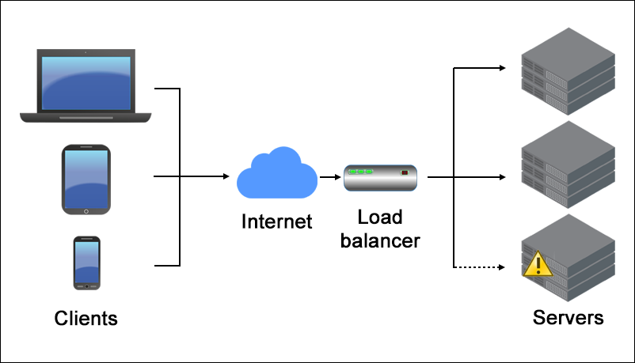
Load Balancing

Slide 4
High Availability

Slide 5
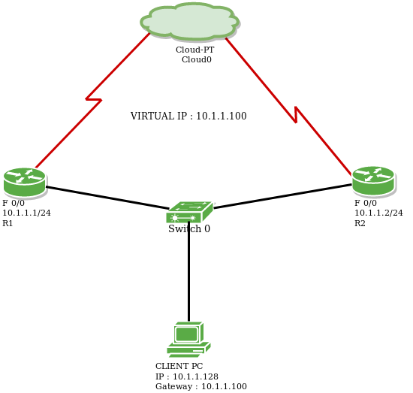
VRRP - Virtual Router Redundancy Protocol
Notes:
The Virtual Router Redundancy Protocol (VRRP) is a computer networking protocol that provides for automatic assignment of available Internet Protocol (IP) routers to participating hosts. This increases the availability and reliability of routing paths via automatic default gateway selections on an IP subnetwork.
The protocol achieves this by the creation of virtual routers, which are an abstract representation of multiple routers, i.e. primary/active and secondary/Standby routers, acting as a group. The virtual router is assigned to act as a default gateway of participating hosts, instead of a physical router. If the physical router that is routing packets on behalf of the virtual router fails, another physical router is selected to automatically replace it. The physical router that is forwarding packets at any given time is called the primary/active router.

Slide 6
SDN (Software Defined Networking)

Slide 7
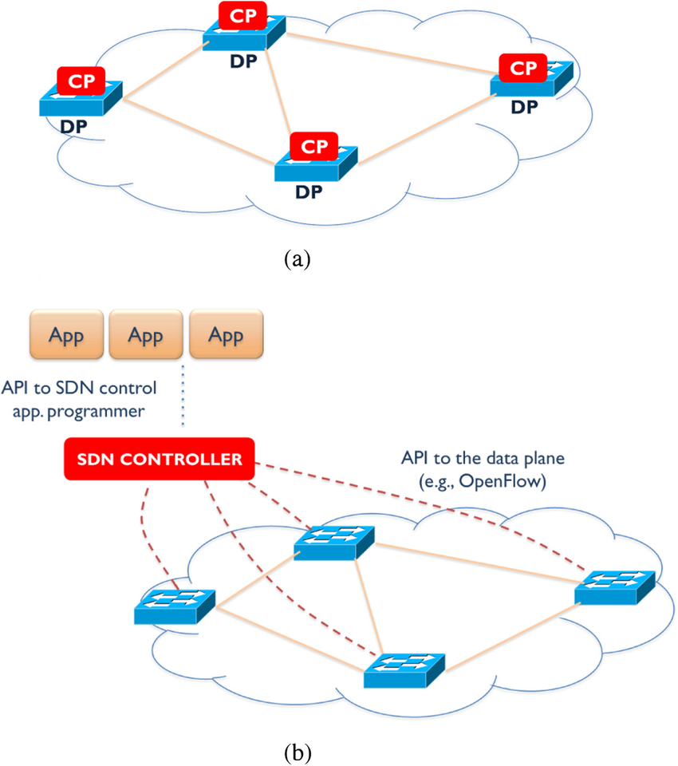
CP - Control Plane DP - Data Plane
Traditional networking
SDN

Slide 8
Network Virtualization

Slide 9
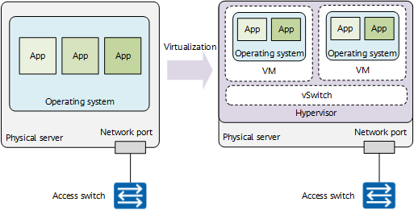
Server Virtualization

Slide 10
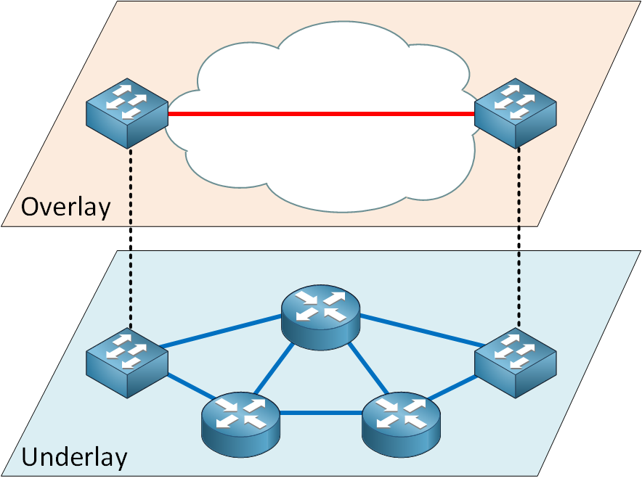
Network Virtualization (Overlay vs Underlay)
Notes:
Network virtualization divides networking into an underlay (physical, hardware-based transport) and an overlay (logical, software-defined network). The underlay provides stable, high-speed connectivity, while the overlay utilizes tunneling (e.g., VXLAN) to provide flexibility, scalability, and security, allowing multiple logical networks to run over one physical infrastructure.
NetworkLessons.com +1
Key Differences Between Overlay and Underlay Networks
Definition: The Underlay is the actual physical network of routers, switches, and cables. The Overlay is a virtual, logical network built on top of the underlay.

Slide 11
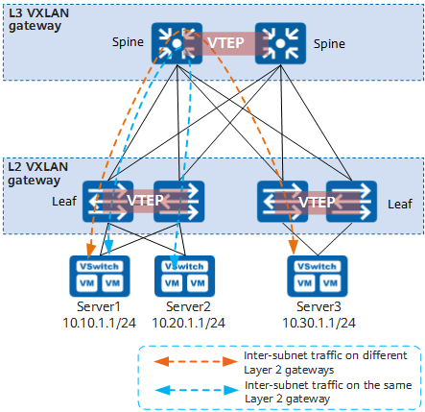
VXLAN
For details, please check this website.
Notes:
Virtual Extensible LAN
VLAN – 12-bit – 4094 + Spanning tree, so unused link
VXLAN – 24-bit – 16 million + No Spanning tree + (tunneling protocol – encapsulate IPv6 packet in the payload of IPv4 packet)
L2 packet gets encapsulated in the payload of the packet + extra info for handling VXLAN (is done by VTEP - VXLAN Tunnel EndPoint)
-----------------------
A VXLAN Tunnel Endpoint (VTEP) is an edge device—either a physical switch or a virtualized server—that encapsulates and de-encapsulates traffic in a Virtual Extensible LAN (VXLAN) network. It enables Layer 2 connectivity over a Layer 3 underlay network by mapping Virtual Network Identifiers (VNIs) to VLANs, serving as the tunnel's start/end point.
Cisco Learning Network +4
Key Aspects of VTEP:
Encapsulation/Decapsulation: VTEPs take Ethernet frames, wrap them in IP/UDP headers (typically UDP port 4789 or 8472), and send them to a destination VTEP.
Interfaces: Each VTEP has two interfaces: a local LAN interface for endpoint communication and an IP interface to the transport network for tunnel communication.

Slide 12
Data Centers and Disaster Recovery

Slide 13
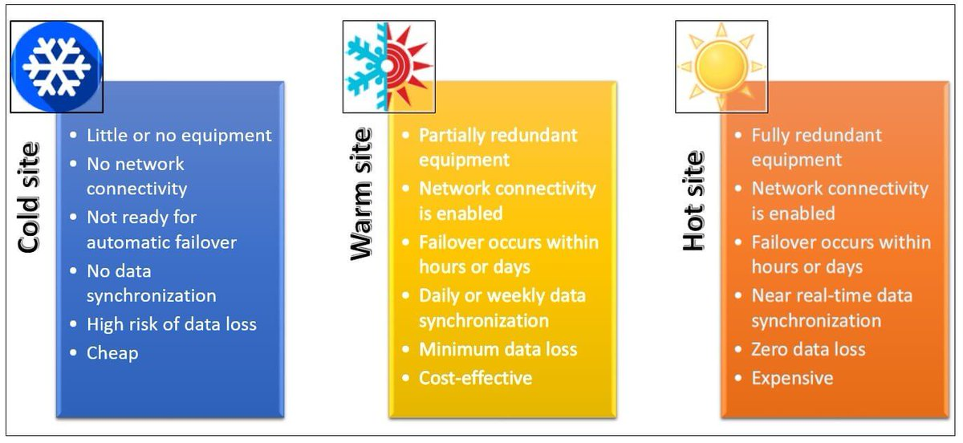
DC-DR

Slide 14
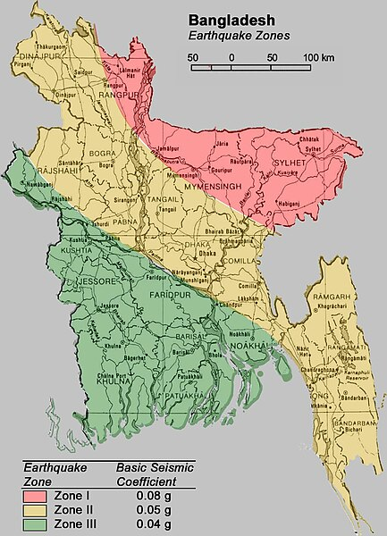
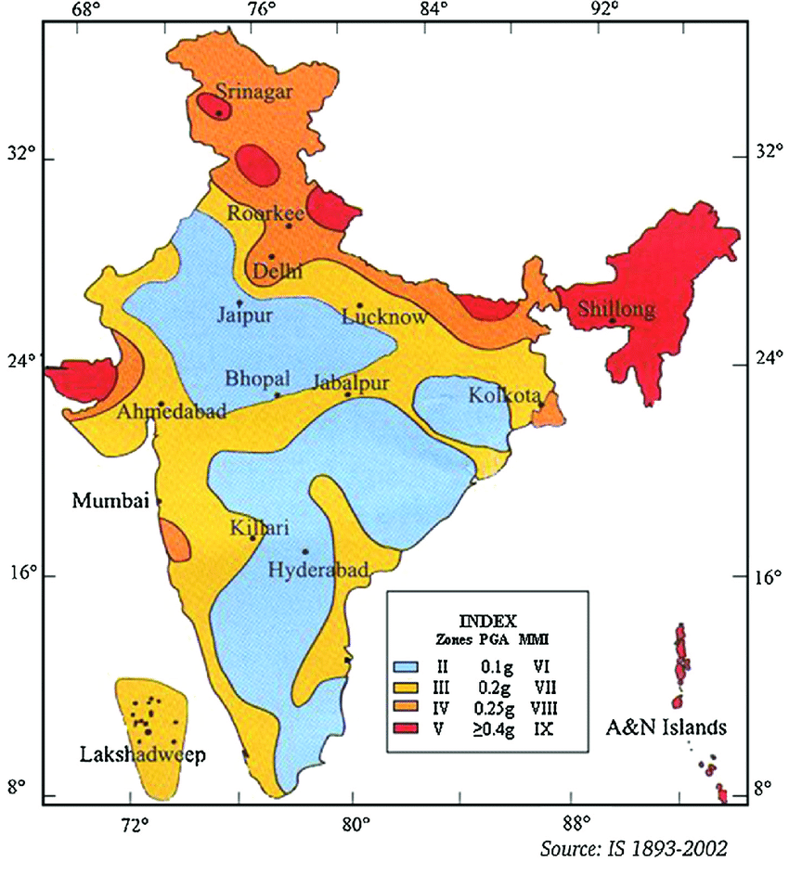
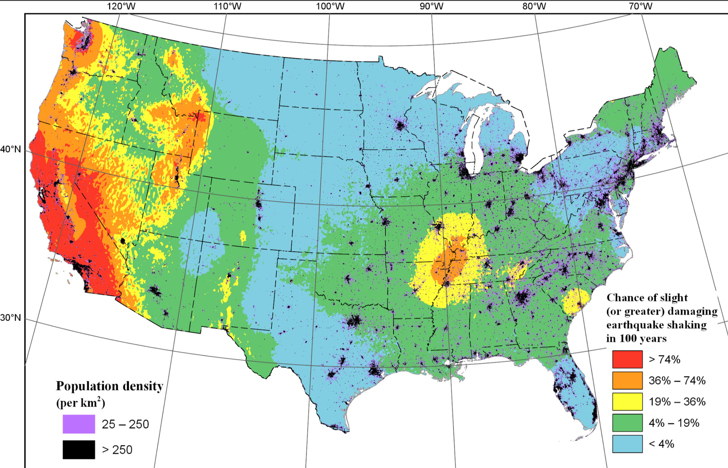
Earthquake Zones – An Important Consideration for DR

Slide 15
Thank You!

